Slide 1
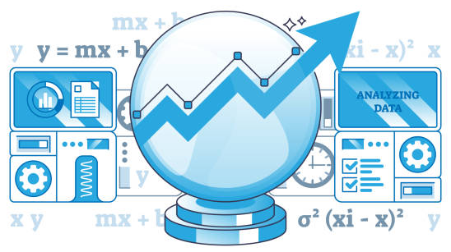
Predictive Model Development for Customer Segmentation
Executive Summary
Problem Definition, Solution Approach, EDA
Data Preprocessing
Model building
Model Performance Evaluation and Improvement
Actionable Insights & Recommendations
Conclusion and Business Recommendations

Slide 2
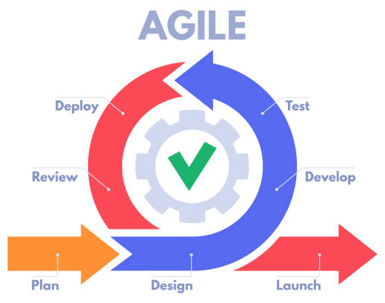
Project Overview
Executive Summary
Problem Definition, Solution Approach, EDA
Problem Definition, Data Background and Contents, Univariate Analysis, Bivariate Analysis, Key Plot Observations.
Data Preprocessing
Data Preparation for Analysis, Missing Value Treatment, Outlier Detection, Feature Engineering, Data Preparation for Modelling
Model building
Decision Tree, Model Evaluation Criterion, Model Building, Model Performance, Visualize Decision Rules and Important Features
Model Performance Evaluation and Improvement
Performance Improvement by Pre and Post Pruning, Compare models' performance - Final Model Selection, Decision Rules and Feature Importance for the Final Model
Actionable Insights & Recommendations
Key Takeaways for the Marketing Team Campaign
Conclusion and Business Recommendations

Slide 3
Executive Summary:
Personal Loan Campaign Targeting using ML (1/2)
Business Context and Project Objective
AllLife Bank seeks to increase its personal loan customers based on their marketing team’s study. The goal of the project is to develop a predictive model to identify prospective customers.
Modeling Approach
A Decision Tree Classifier was developed to classify customers as likely or unlikely to take a loan.
The dataset was split into training and test sets to evaluate model’s performance.
Model performance was evaluated using Accuracy, Precision, Recall, and F1 Score.
Important Predictors for Personal Loan Customers
Income: Higher income customers are more likely to take personal loans.
CD Account: Strong indicator of likelihood to accept loans.
Education Level: Advanced education correlates with higher acceptance.
Average Credit Card Spend: A proxy for financial activity level.

Slide 4
Executive Summary:
Personal Loan Campaign Targeting using ML (2/2)
Actionable Insights
Targeting Strategy:
Focus marketing on high-income customers with high credit card spending and advanced education.
Avoid general population campaigns—focus on identified segments to optimize ROI.
Channel Optimization:
Customers using online banking and credit cards show stronger engagement—leverage digital channels for campaign delivery.
Cross-Selling Opportunity:
Promote personal loans during CD account promotions or credit card engagements.
Recommendations for Business
Deploy the model into the marketing workflow to generate leads for the next campaign cycle.
Track and retrain the model periodically with new campaign results to adapt to evolving customer behavior.
Invest in feature enrichment—include behavioral data (e.g., transaction volume, recent deposit activity) for improved targeting.
Explore ensemble methods (e.g., Random Forest, XGBoost) for potentially higher predictive power.
Additional data needs (e.g., identification of existing business owners, credit scores and life events of customers and their income trends etc.)

Slide 5

Business Problem Overview
GOAL:
Improve the adoption rate of the bank’s Personal Loan product by identifying which existing customers are most likely to accept a loan offer.
CHALLENGE:
Despite offering a wide range of services, the personal loan has low customer uptake. Traditional blanket marketing is inefficient and costly.
SOLUTION:
Use a machine learning model to predict loan acceptance based on customer attributes like income, spending habits, account activity, and demographics.
IMPACT:
Focus marketing efforts on high-likelihood customers
Increase personal loan conversions
Lower customer acquisition costs
Boost overall loan revenue

Slide 6
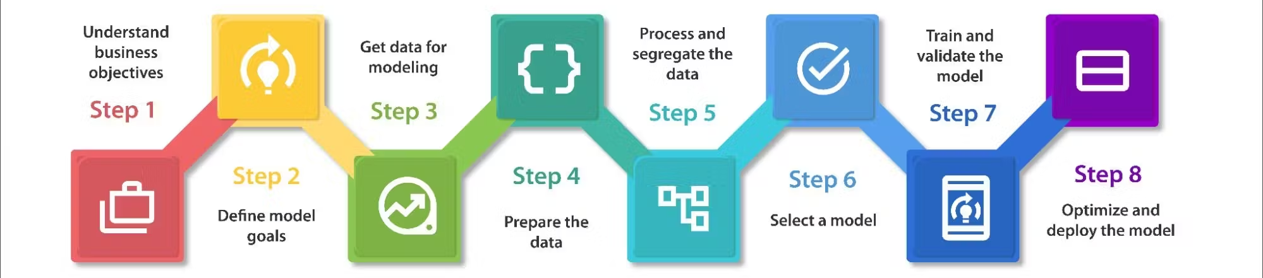
Solution Approach and Methodology
Business Understanding
Define objective: Predict which customers are likely to accept a personal loan offer
Align model outputs with marketing strategy
Data Preparation
Clean data (e.g., handle negative experience values)
Encode categorical variables
Remove highly correlated / redundant features
Model Building
Train a Decision Tree Classifier to predict Personal_Loan
Use Gini impurity for splitting
Split data into training (70%) and test (30%)
Model Interpretation
Visualize decision rules and feature importance
Enable actionable insights for targeted marketing
Data Understanding
Analyze historical customer data (demographics, financial behavior, account activity)
Identify patterns between attributes and loan acceptance
Exploratory Data Analysis (EDA)
Visualize feature distributions and relationships
Identify key drivers (e.g., income, credit card usage, CD account)
Model Evaluation & Tuning
Evaluate using accuracy, precision, recall, and F1-score
Use confusion matrix to assess misclassifications
Tune hyperparameters (depth, leaf nodes, splits) for better generalization
Deployment & Monitoring
Integrate with marketing systems for customer targeting
Continuously monitor performance and retrain as needed

Slide 7

Data Background and Contents
📦 Source: Retail bank's internal dataset of 5,000 customers, with 14 attributes / features of each customer.
🎯 Objective: Use customer data to predict likelihood of personal loan acceptance
🧾 Data Structure:
Rows: 5,000 individual customers
Columns: 14 features (demographic, behavioral, financial)
Key Features
Category | Features
Demographic | Age, Experience, ZIP Code, Family, Education
Financial | Income, Mortgage, CCAvg (monthly credit card spend)
Bank Products | Securities_Account, CD_Account, Credit Card, Online Banking
Target | Personal_Loan (0 = No, 1 = Yes)

Slide 8
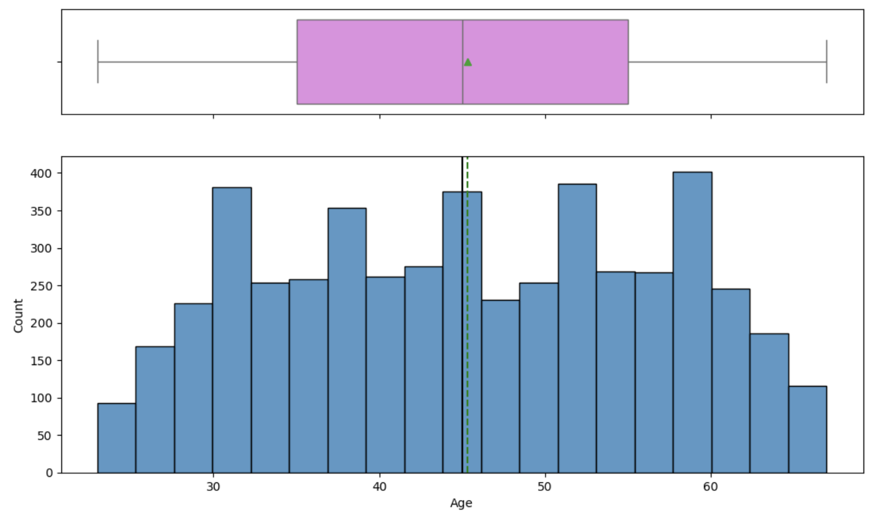
Univariate Analysis - Numerical Features Overview (1/5 )
Age
Range: 23 to 67 years
Median = 45
Fairly balanced across age groups, centered around mid-40s

Slide 9
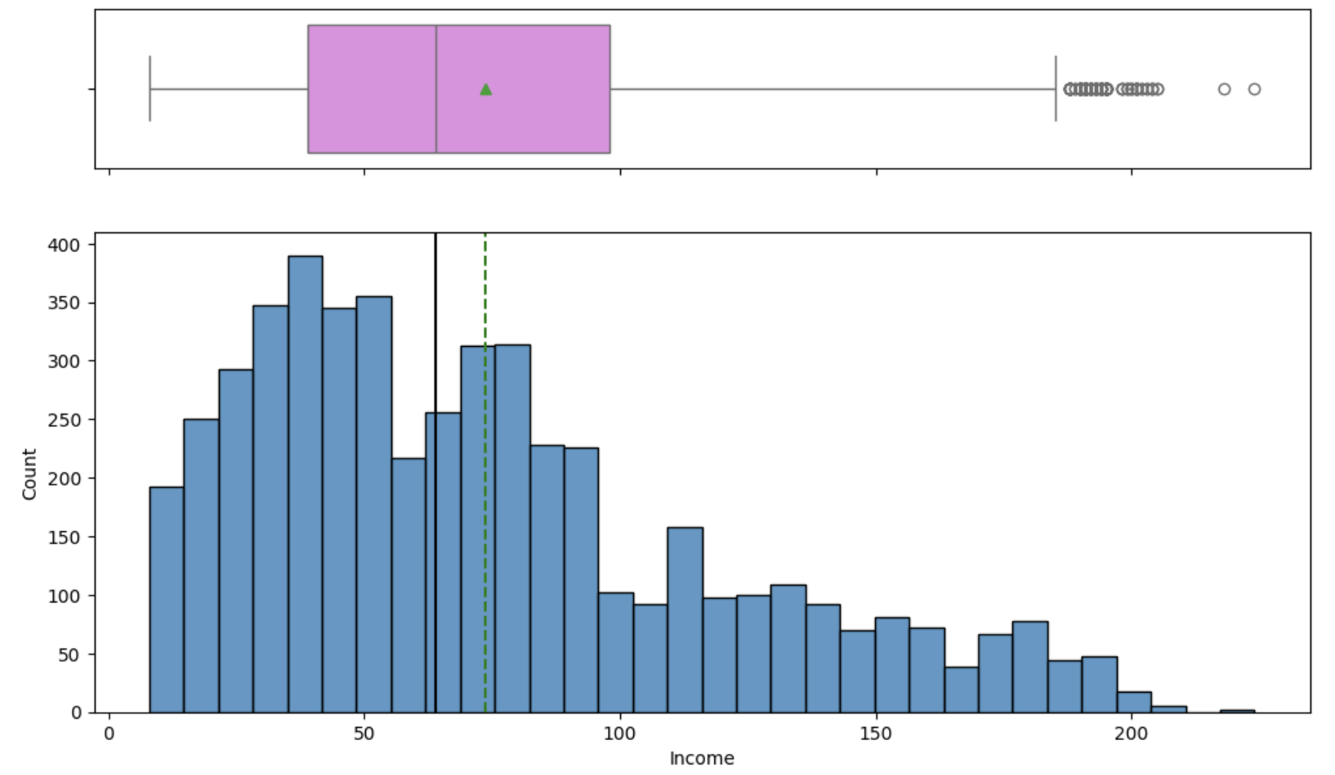
Univariate Analysis - Numerical Features Overview (2/5 )
Income (in $1,000s)
Range: 8 to 224;
Median = 64
Mean = 74
Right-skewed; few high-income earners pull up the average

Slide 10
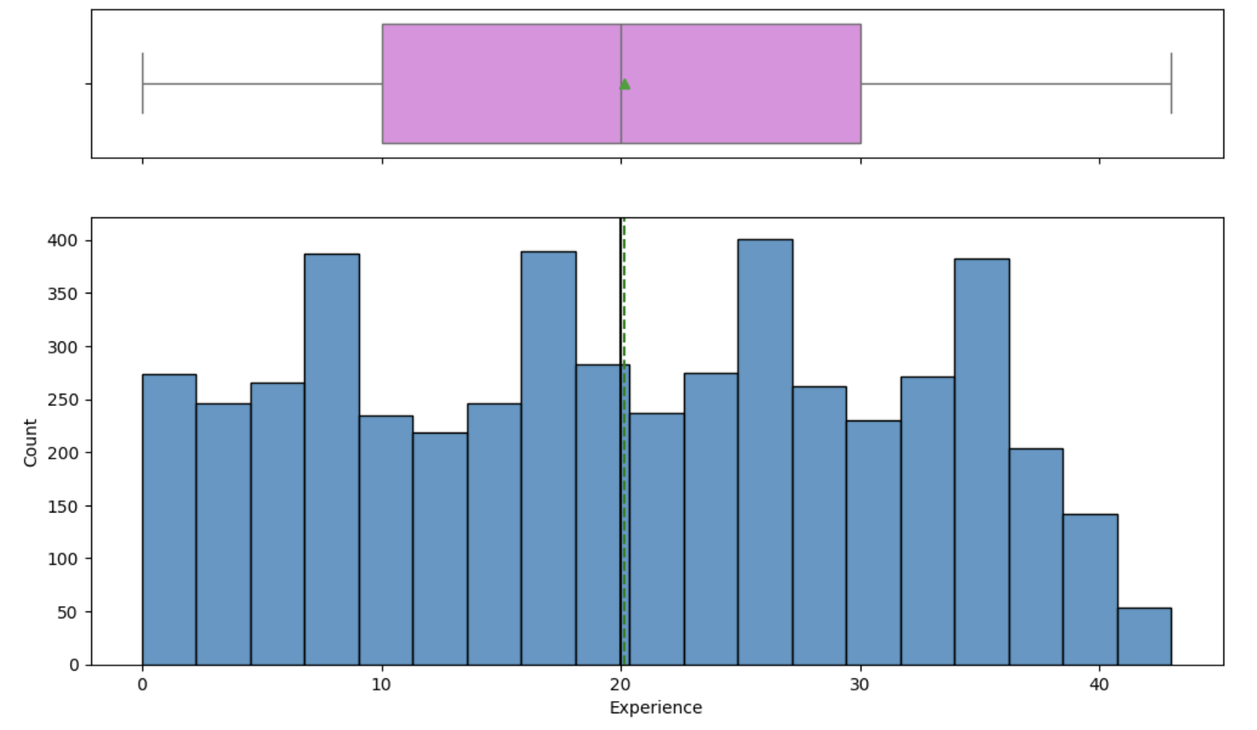
Univariate Analysis - Numerical Features Overview (3/5 )
Experience
Range: 0 to 43 years
Median = 20
Slightly skewed toward younger professionals with under 30 years of experience

Slide 11
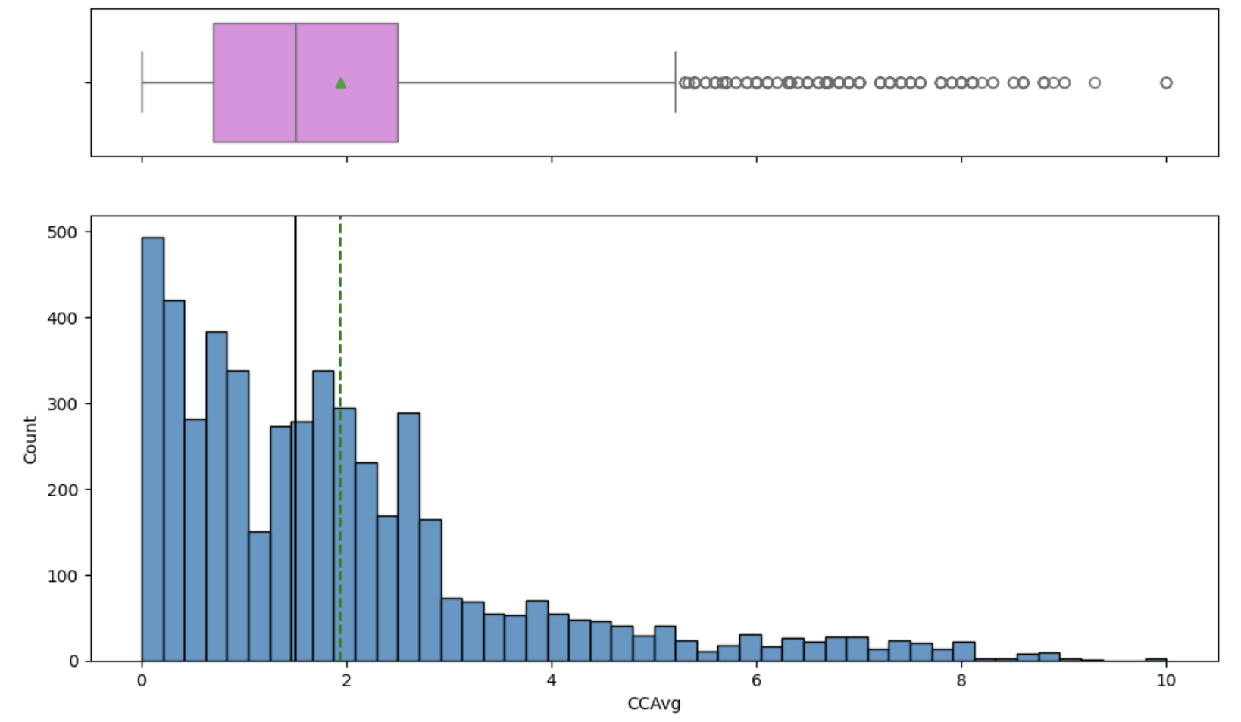
Univariate Analysis - Numerical Features Overview (4/5 )
CCAvg (Monthly Credit Card Spend)
Range: 0 to 10
Median = 1.5
Most customers have relatively modest credit card spend

Slide 12
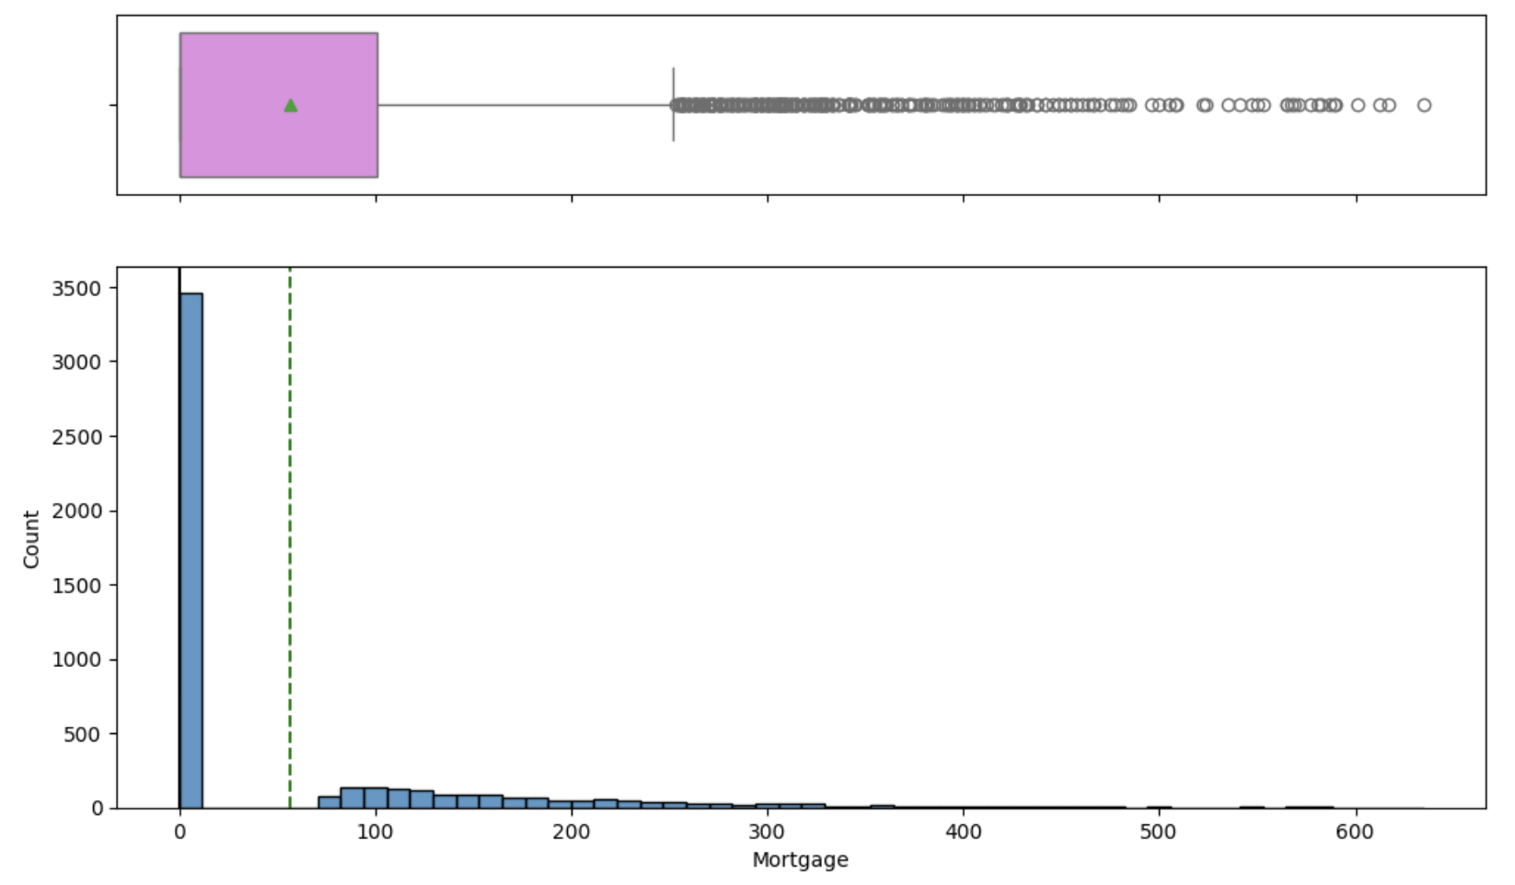
Univariate Analysis - Numerical Features Overview (5/5)
Mortgage (in $1,000s)
50% of customers have zero mortgage
Median = 0
Mean pulled up by few with large mortgage (Max = 635)

Slide 13
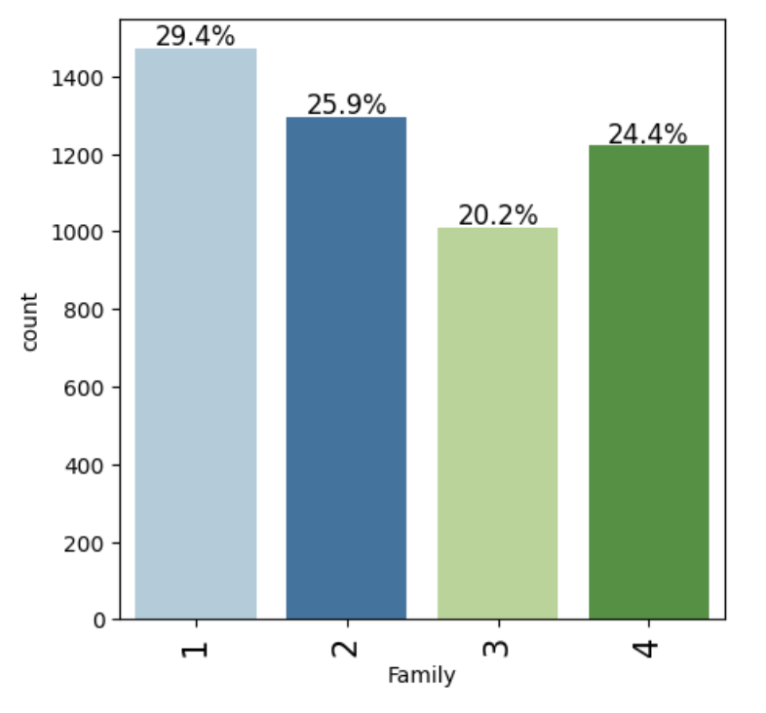
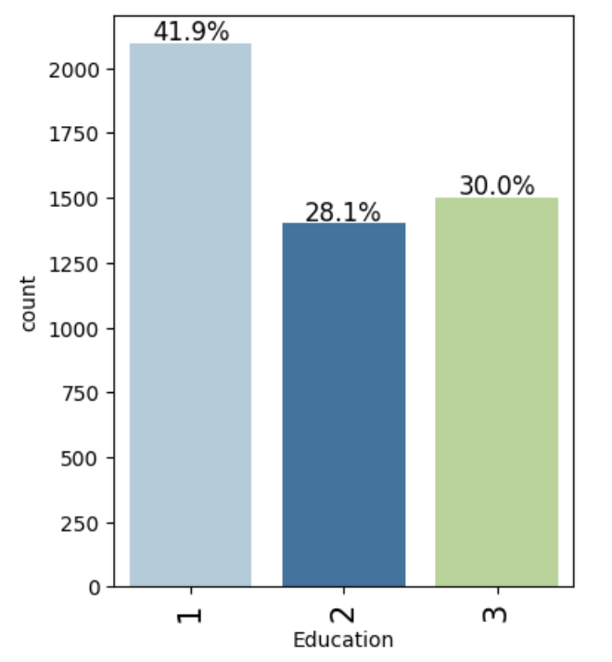
Univariate Analysis - Categorical Features Overview (1/3)
Most common family sizes: 1 (29%), 2 (26%), and 4 (24%)
Undergrad (Level 1): 42%
Graduate: 28%, Advanced/Professional: 30%

Slide 14
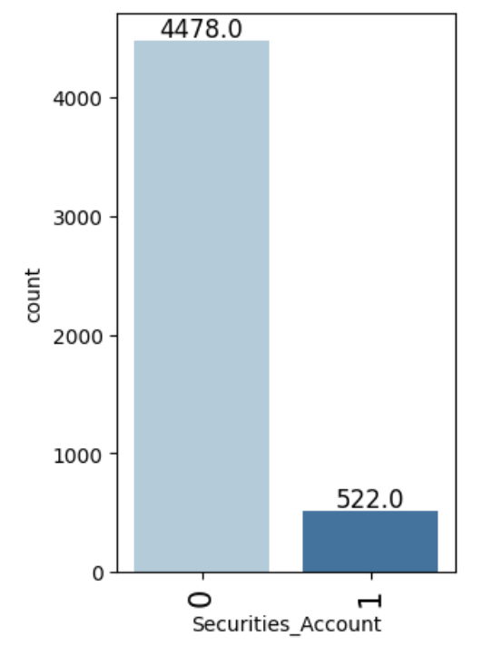
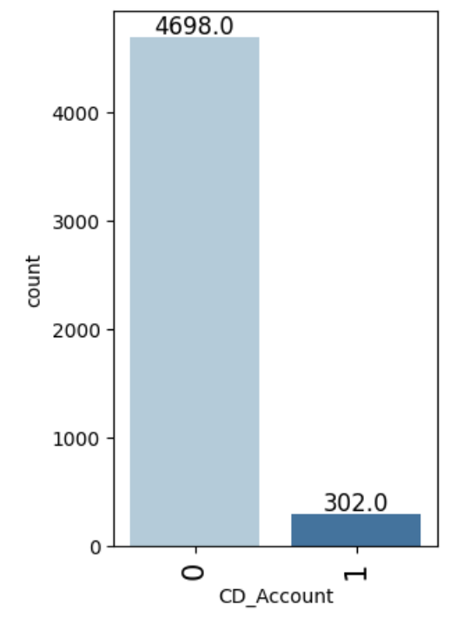
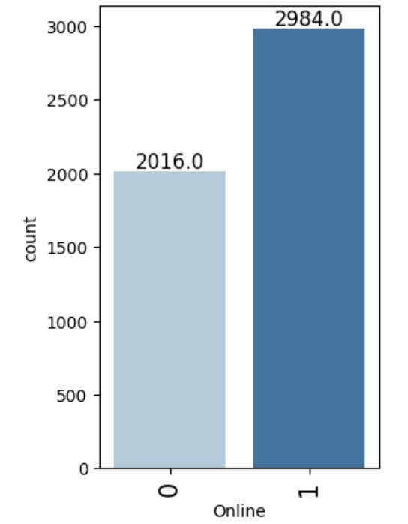
Univariate Analysis - Categorical Features Overview (2/3)
60% use it; digital adoption is fairly strong
Only 10% of customers have one
Very low adoption (6% only)

Slide 15
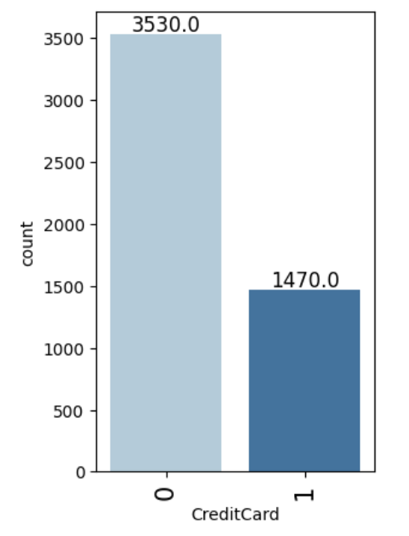
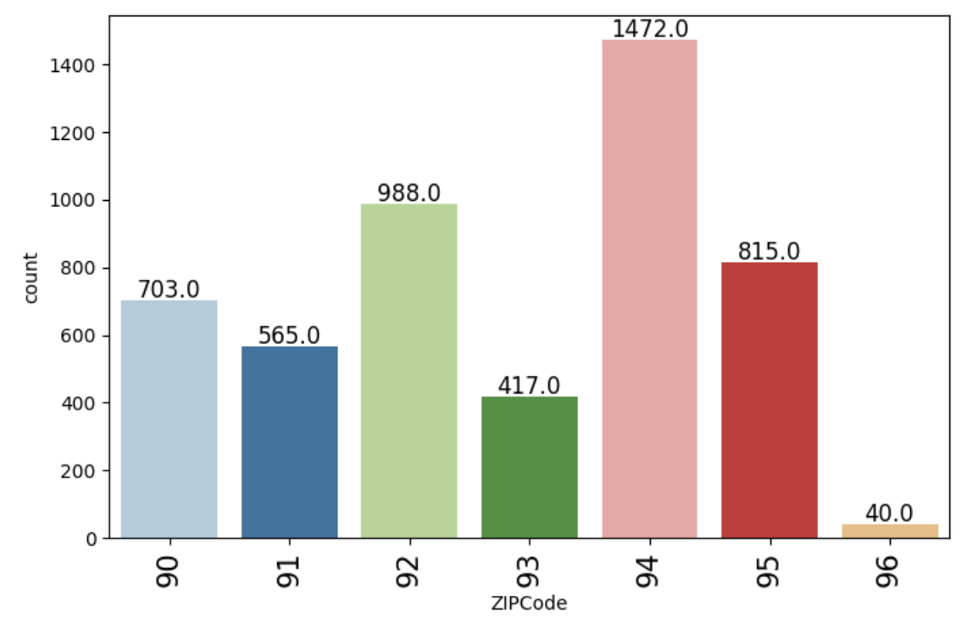
Univariate Analysis - Categorical Features Overview (3/3)
94 zip code has the highest customers
29% have a credit card with the bank

Slide 16

Bivariate Analysis - Categorical Features Overview (1/5 )
1.Education Level
Customers with higher education (Graduate/Advanced degrees) are more likely to take a personal loan.
Undergrad (Level 1): only 4.4% took a loan
Graduate (Level 2): 13% took a loan
Advanced (Level 3): 13.7% took a loan
2. Family Size
Loan uptake is slightly higher for 2- and 3-member families
Family size 1: 7.3%
Family size 2: 8.2%
Family size 4: slightly less than 2/3-member families
3. CD Account
Not a significant feature for personal loan:
Only 6% of customers with a CD account took a loan
6.8% without a CD account took the loan
4. Securities Account
Minimal impact:
Loan uptake rate only 10% higher for those with a securities account
5. Online Banking
Customers are nearly equally split in terms of online banking use:
Loan acceptance is nearly same across customers with respect to use of online banking
6. Credit Card
Little to no effect:
Customers with and without a credit card have nearly equal loan uptake

Slide 17
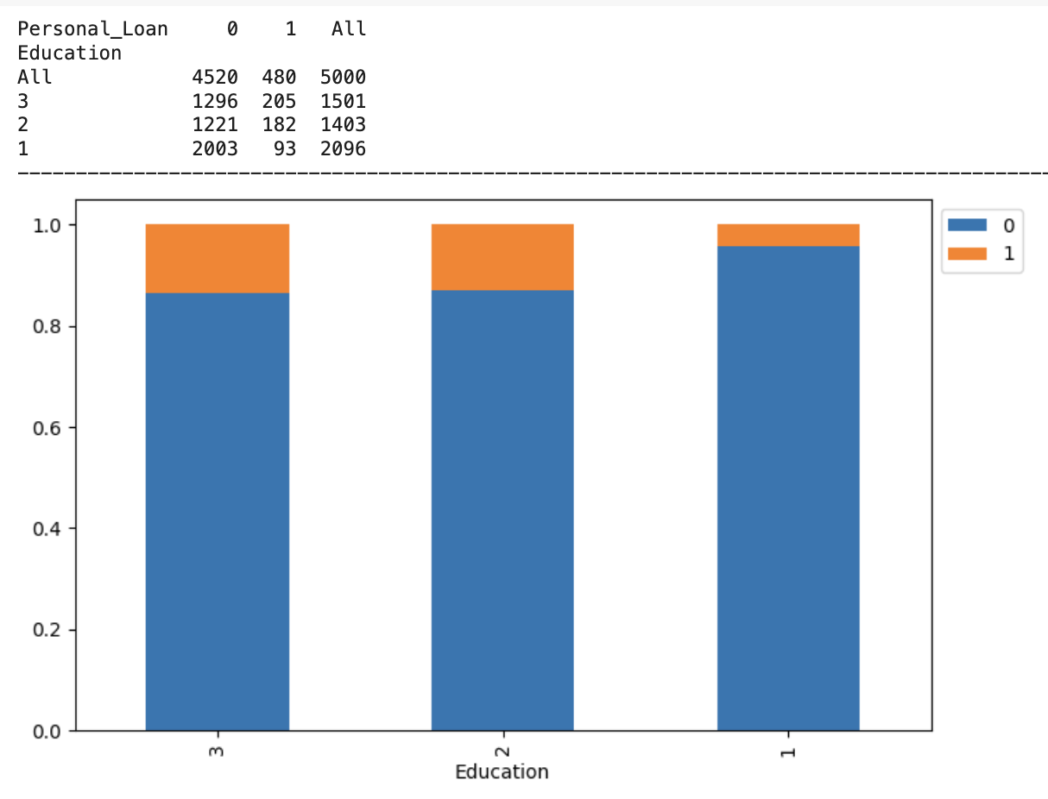
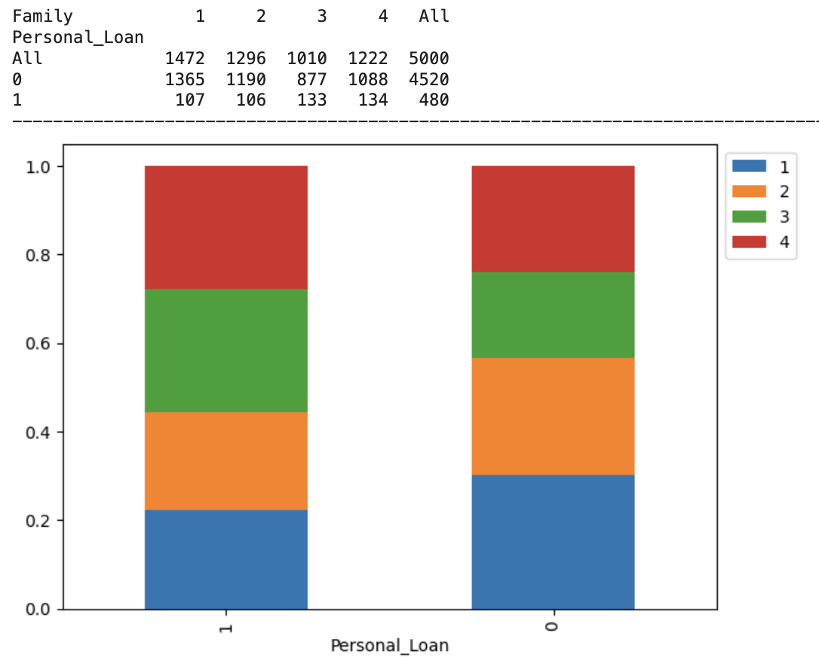
Bivariate Analysis - Categorical Features Overview (2/5 )

Slide 18
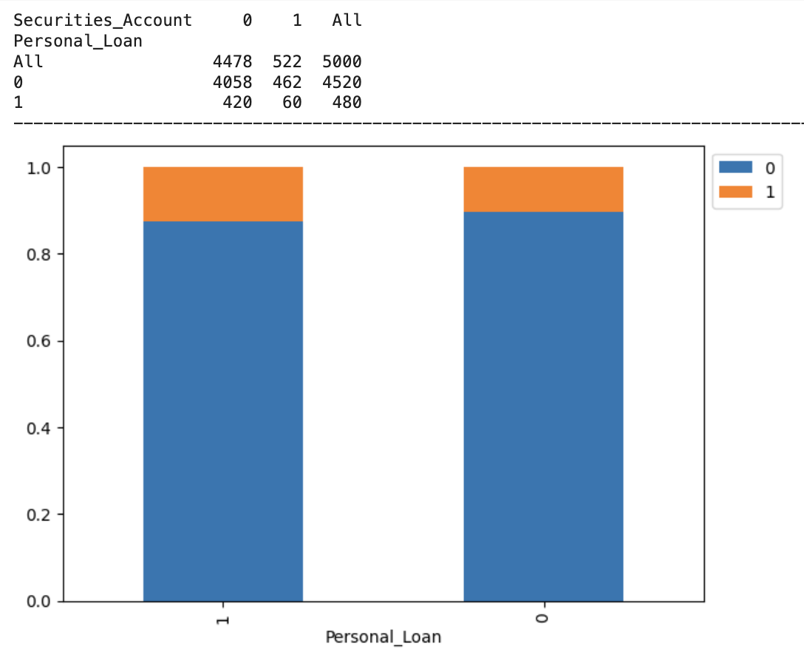
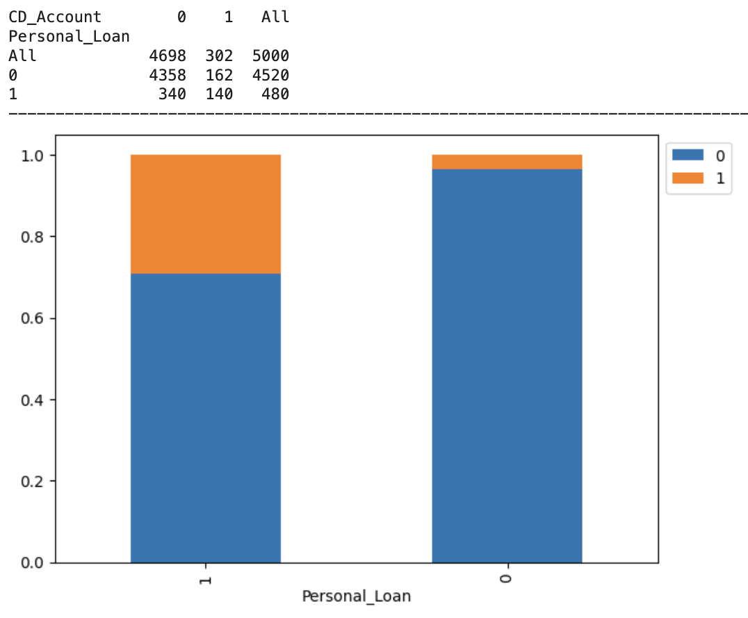
Bivariate Analysis - Categorical Features Overview (3/5 )

Slide 19
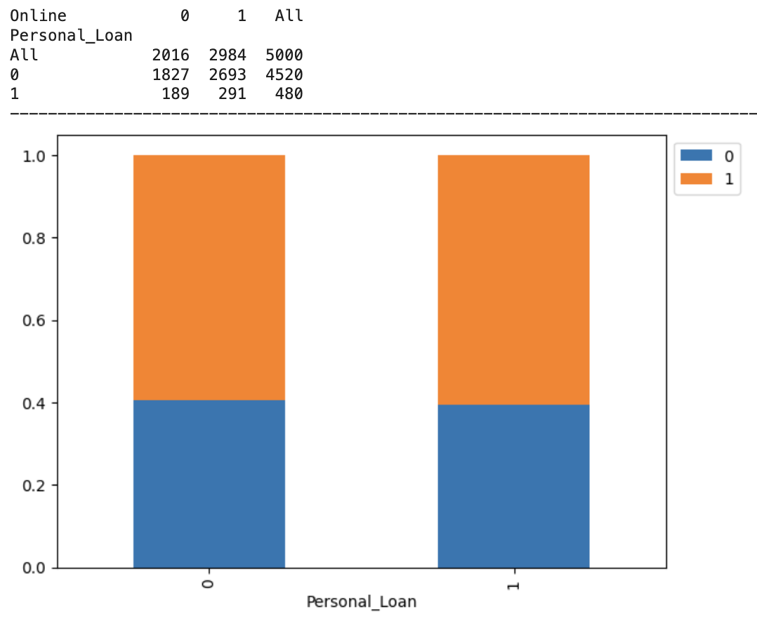
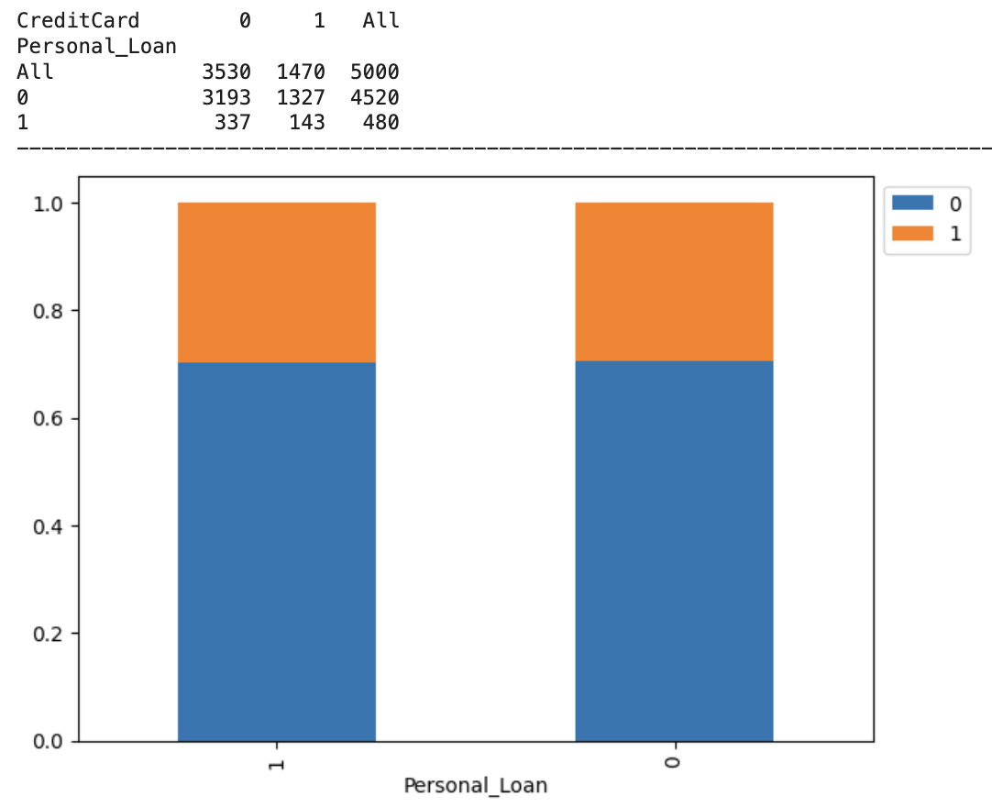
Bivariate Analysis - Categorical Features Overview (4/5)

Slide 20
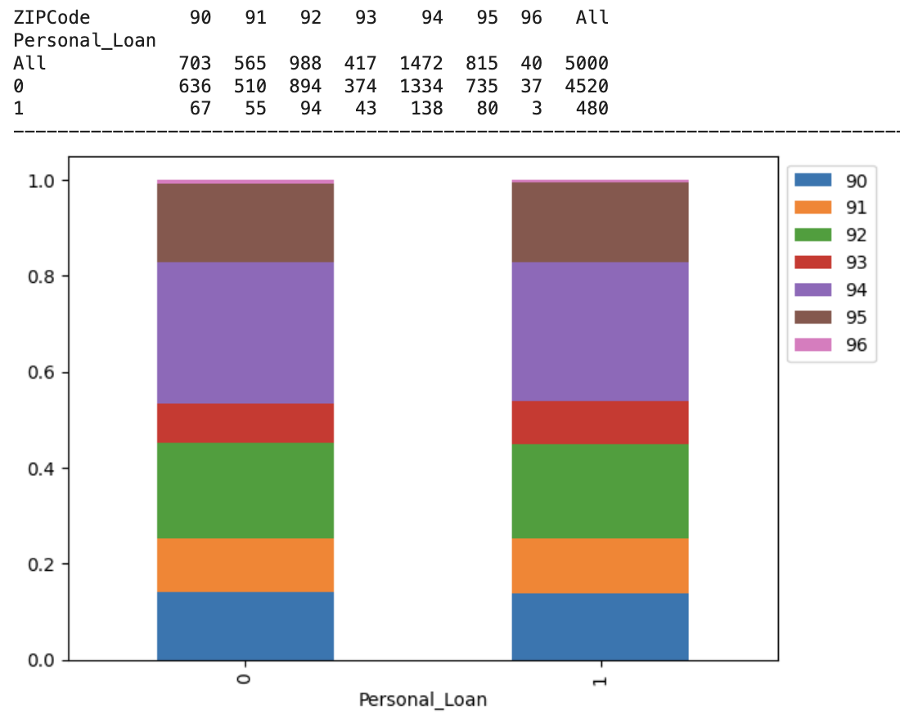
Bivariate Analysis - Categorical Features Overview (5/5)

Slide 21
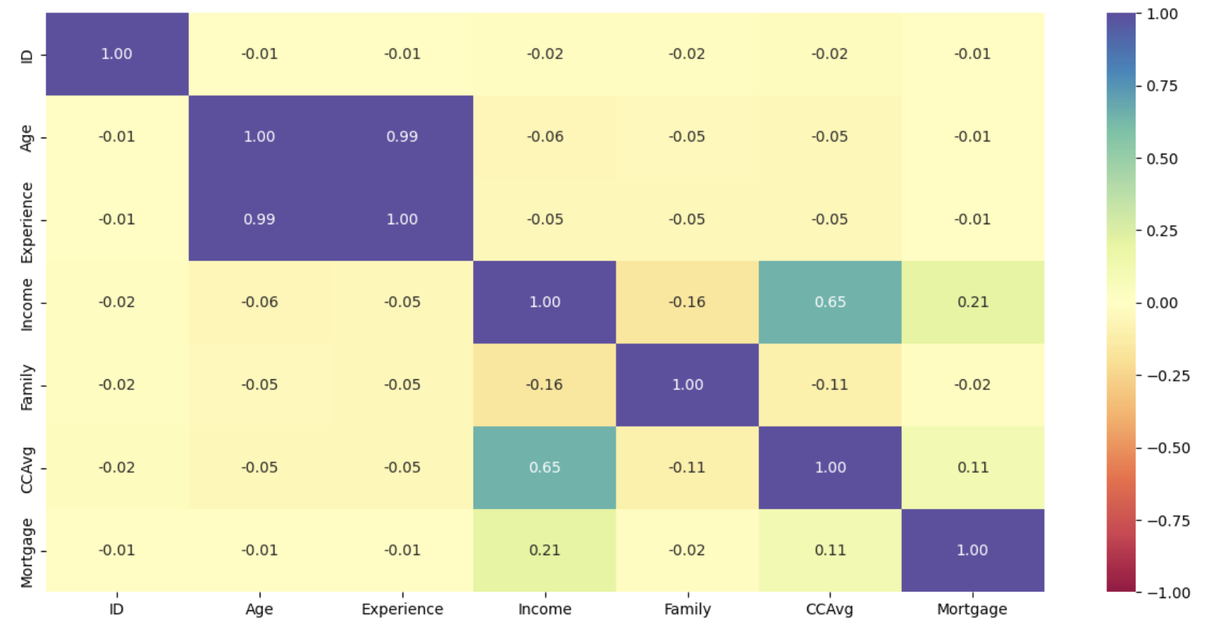
Bivariate Analysis - Numerical Features Heatmap Overview (1/6)
Strongest Correlation with Loan Acceptance (Personal_Loan):
Income and CCAvg are highly correlated (+0.65)
Income and Mortgage are also closely correlated (+0.21)
Low/Negligible Correlation:
Age, Experience, Family all have near zero correlation
Family and Income have the highest negative correlation (-0.16)

Slide 22

Bivariate Analysis - Numerical Features Overview (2/6)
1. Income
🔑 Most influential numerical variable
Customers who accepted loans had:
Mean income: $145K vs. $66K (no loan) Median income: $142.5K vs. $59K
Indicates strong positive association between higher income and loan acceptance
2. CCAvg (Monthly Credit Card Spend)
Customers who took loans had:
Mean spend: 3.9 vs. 1.7 Median spend: 3.8 vs. 1.4
High spenders are significantly more likely to take a loan
3. Mortgage
Mean mortgage is nearly double for those who accepted loans
Mean: $101K (loan) vs. $52K (no loan)
But median mortgage is 0 for both groups, suggesting a skewed distribution
4. Age
No difference in central tendency Mean and median are both ~45 for both groups
Not a useful predictor
5. Experience
Almost identical across groups
Mean and median = 20 years
Not significant for prediction

Slide 23
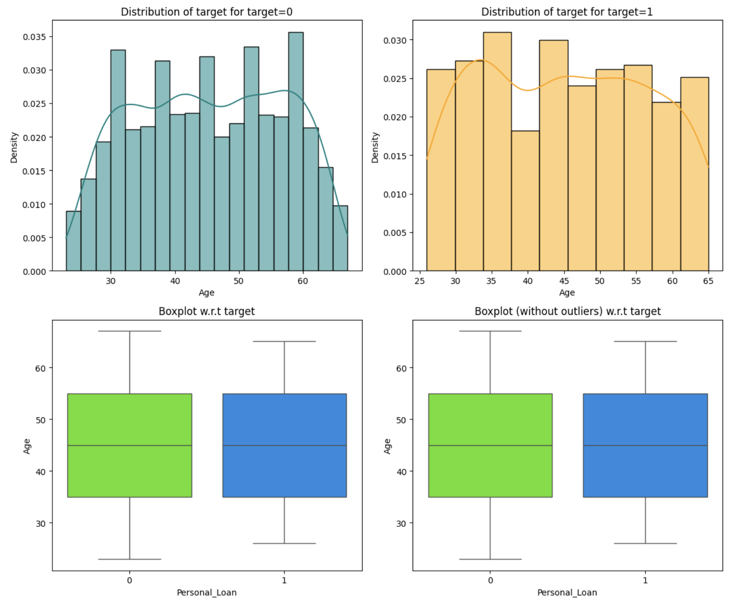
Bivariate Analysis - Numerical Features Overview (3/6 )

Slide 24
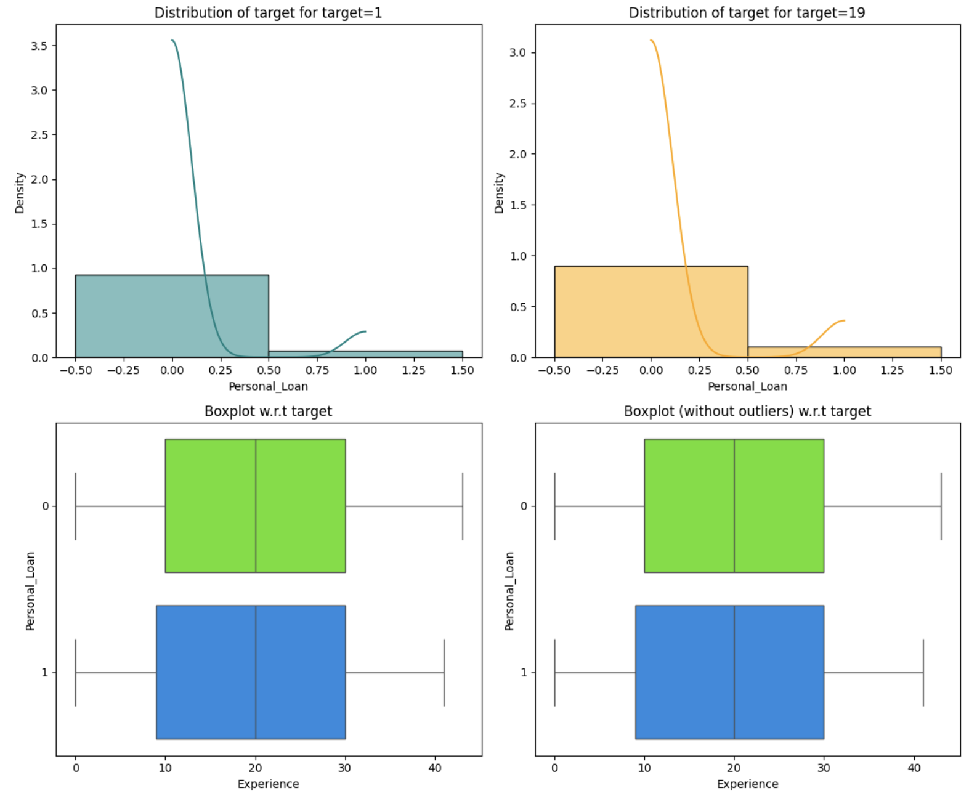
Bivariate Analysis - Numerical Features Overview (4/6 )

Slide 25
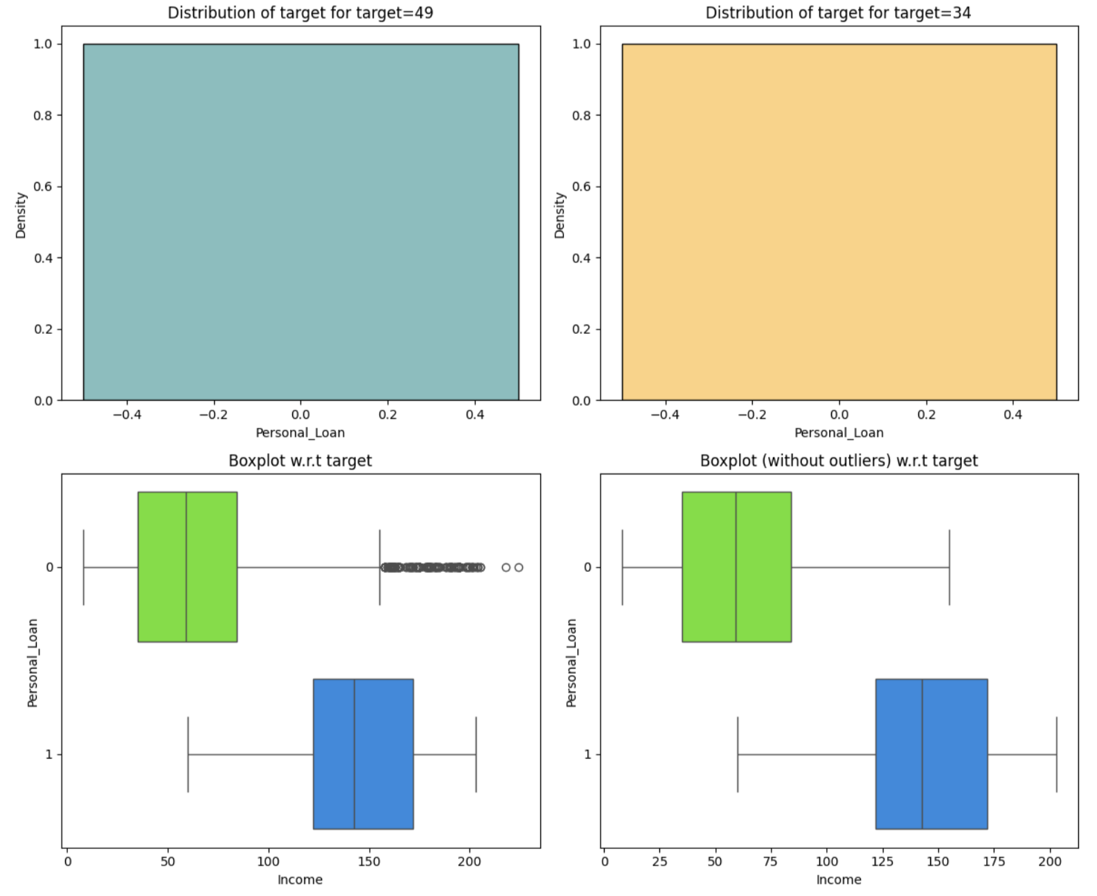
Bivariate Analysis - Numerical Features Overview (5/6 )

Slide 26
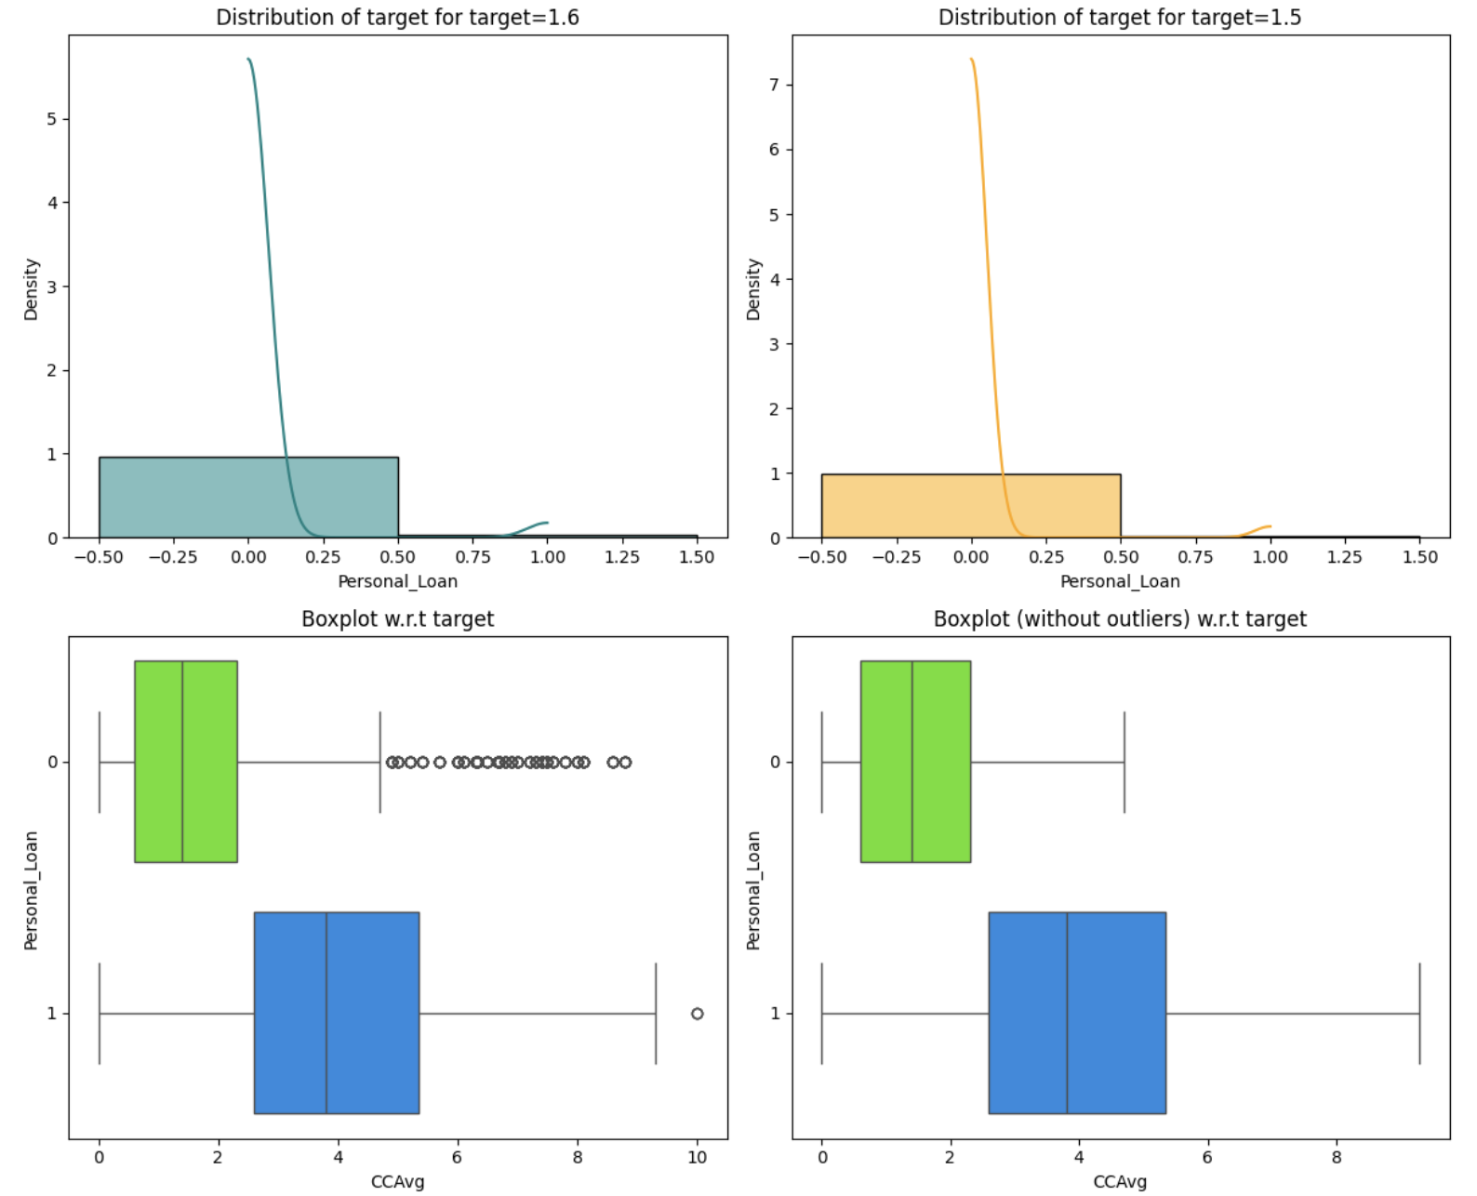
Bivariate Analysis - Numerical Features Overview (6/6 )

Slide 27

Data Preprocessing (1/2 )
🔧 1. Missing Value Treatment
No explicit missing value treatment was performed
No use of isnull(), fillna(), or dropna().
Dataset does not contain missing values.
🚨 2. Outlier Detection
Interquartile Range (IQR) method used for identifying outliers in numeric columns:
Calculated Q1, Q3, and IQR = Q3 - Q1
Computed lower and upper bounds:
lower = Q1 - 1.5 * IQR,
upper = Q3 + 1.5 * IQR
Counted how many values lie outside these bounds (not removed but flagged)

Slide 28
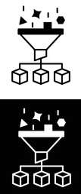
Data Preprocessing (2/2)
🛠️ 3. Feature Engineering
Experience: Fixed unrealistic negative values: -1, -2, -3 replaced with 1, 2, 3 ZIPCode: Converted to first two digits only (region-level granularity)
Changed to categorical variable
Education, CD_Account, Online, etc.:
Converted to categorical dtype for better memory use and modeling
📦 4. Data Preparation for Modeling
Feature Selection:
Dropped Experience due to high correlation with Age
One-Hot Encoding:
Applied to ZIPCode and Education using pd.get_dummies() with drop_first=True
Train-Test Split: 70% train, 30% test
Used train_test_split() from sklearn.model_selection
Data Type Conversion:
Ensured all input features were converted to float for model compatibility

Slide 29
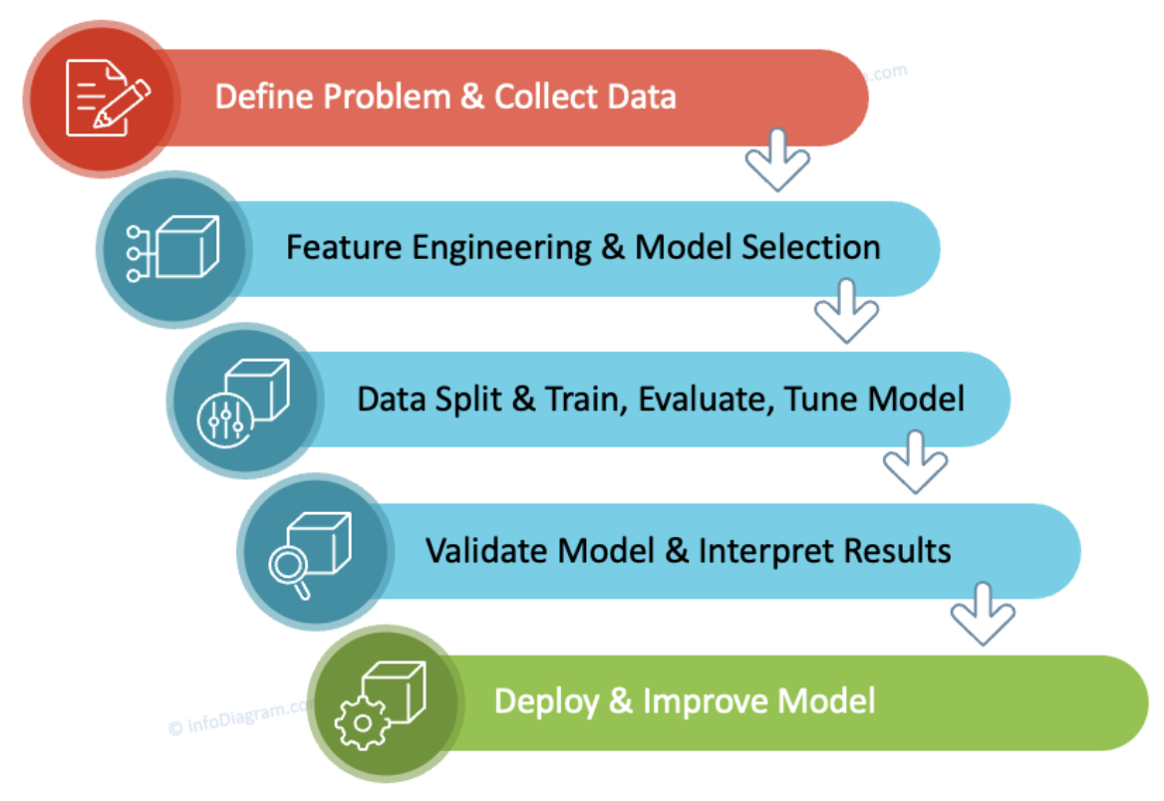
Model Building (1/3)
🌳 1. Model Type: Decision Tree
The model used is a DecisionTreeClassifier from sklearn.tree
Criterion: Gini impurity
Random seed: random_state=1 for reproducibility
📊 2. Model Evaluation Criteria
Custom function model_performance_classification_sklearn() evaluates:
Accuracy – overall correctness of the model
Recall – how well the model identifies true positives (sensitive to false negatives)
Precision – how many predicted positives are actually correct
F1 Score – harmonic mean of precision and recall (balances both)
Confusion matrix is visualized using:
confusion_matrix_sklearn(model, X_train, y_train)

Slide 30
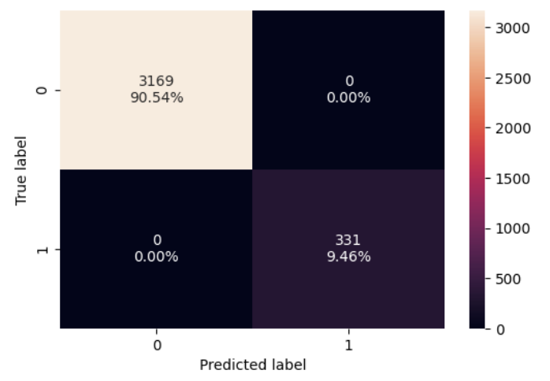
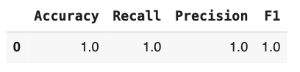
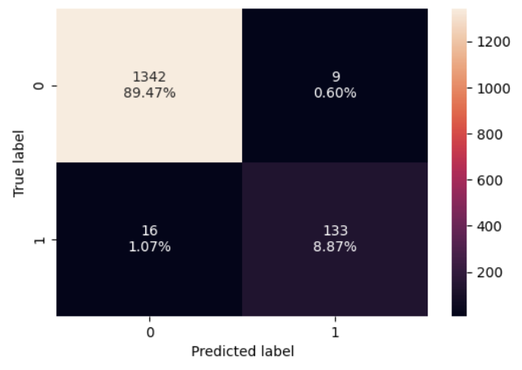
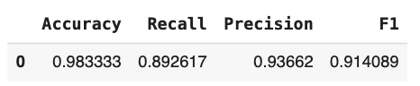
Model Building (2/3)
Training Data
🏗️ 3. Model Building Process
Model is trained using python command: model = DecisionTreeClassifier(criterion="gini", random_state=1)
model.fit(X_train, y_train)
Data used: one-hot encoded features + 70/30 train-test split
Evaluation run on training data first, then test set
✅ 4. Model Performance
Performance metrics (on training data) are stored in: decision_tree_perf_train = model_performance_classification_sklearn(model, X_train, y_train)
A similar approach is used for test performance later using X_test, y_test
Test Data

Slide 31
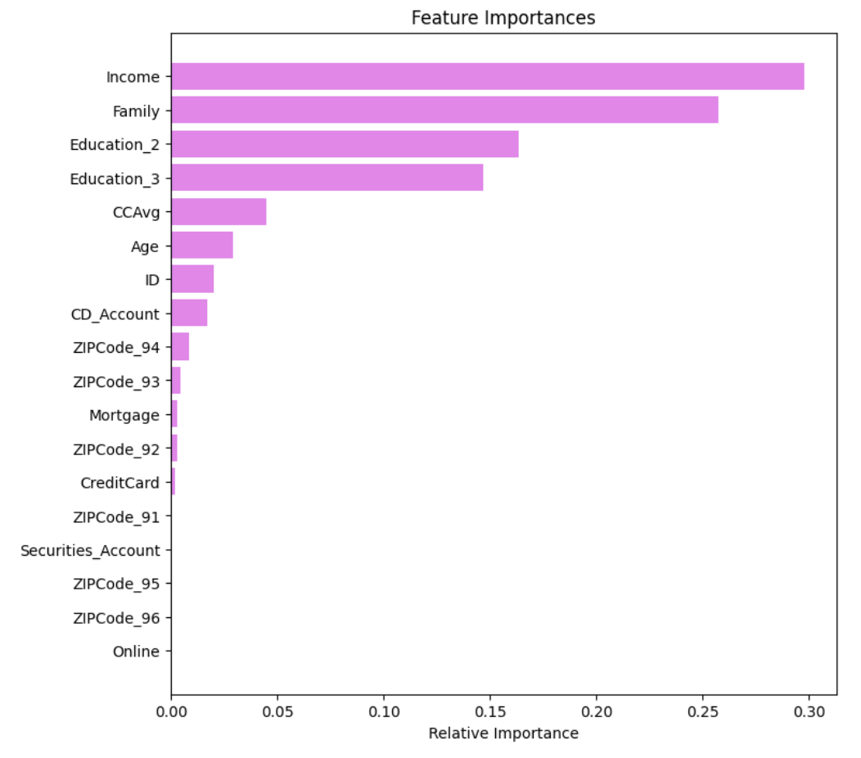
Model Building (3/3)
🌲 5. Visualizing the Decision Rules
Full decision tree is plotted using: tree.plot_tree(model, feature_names=feature_names, filled=True)
Additional rule summary printed using: print(tree.export_text(model, feature_names=feature_names, show_weights=True))
⭐ 6. Feature Importance
Ranked via: model.feature_importances_
Visualized using horizontal bar chart: plt.barh(...)
Top features include:
Income
Family
Education

Slide 32
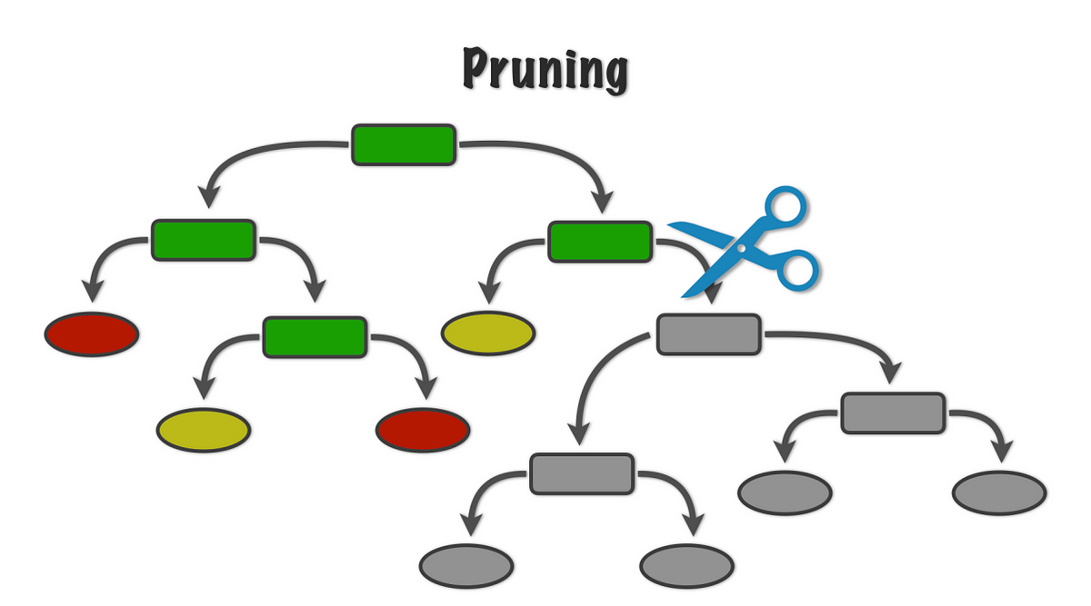
Performance Improvement by Pre-Pruning (1/4)
🌱 Pre-Pruning Strategy Used
Applied pre-pruning by tuning the following hyperparameters of the DecisionTreeClassifier:
max_depth: [2, 7, 2]
max_leaf_nodes: [50, 75, 150, 250]
min_samples_split: [10, 30, 50, 70]
Each combination is trained and evaluated using:
Training recall score
Test recall score
Absolute difference between the two (to minimize overfitting)
🧠 Selection Criterion
The best model was selected by:
Minimizing the difference between train and test recall (indicating lower overfitting)
Maximizing the test recall score (to catch more positives)

Slide 33
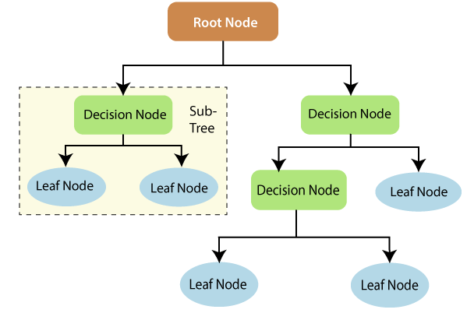

Performance Improvement by Pre-Pruning (2/4)
✅ Resulting Best Model
The code prints out the optimal parameters found: print(f"Max depth: {best_estimator.max_depth}")
print(f"Max leaf nodes: {best_estimator.max_leaf_nodes}")
print(f"Min samples split: {best_estimator.min_samples_split}")
print(f"Best test recall score: {best_test_score}")
This model is then refit on training data and evaluated on both:
Training set (decision_tree_tune_perf_train)
Test set (decision_tree_tune_perf_test)
📉 Effect of Pre-Pruning
Reduces model complexity
Improves generalization
The tree likely becomes shallower with fewer nodes, as confirmed in the later section using cost-complexity pruning plots (ccp_alpha tuning)

Slide 34
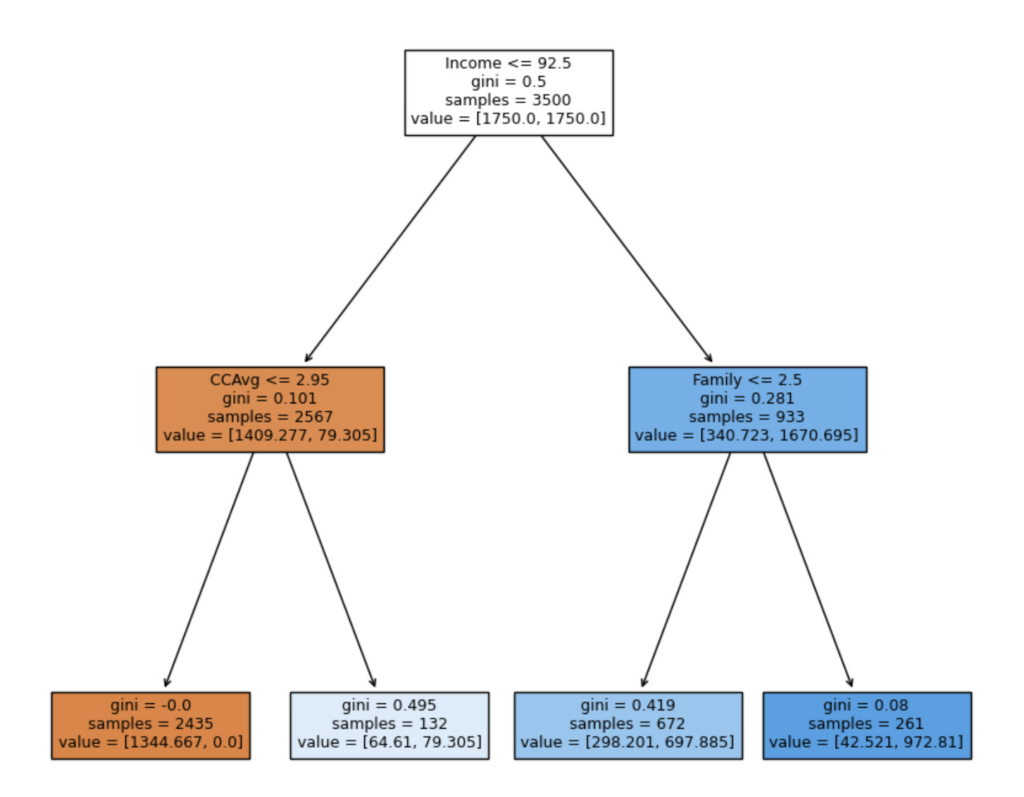
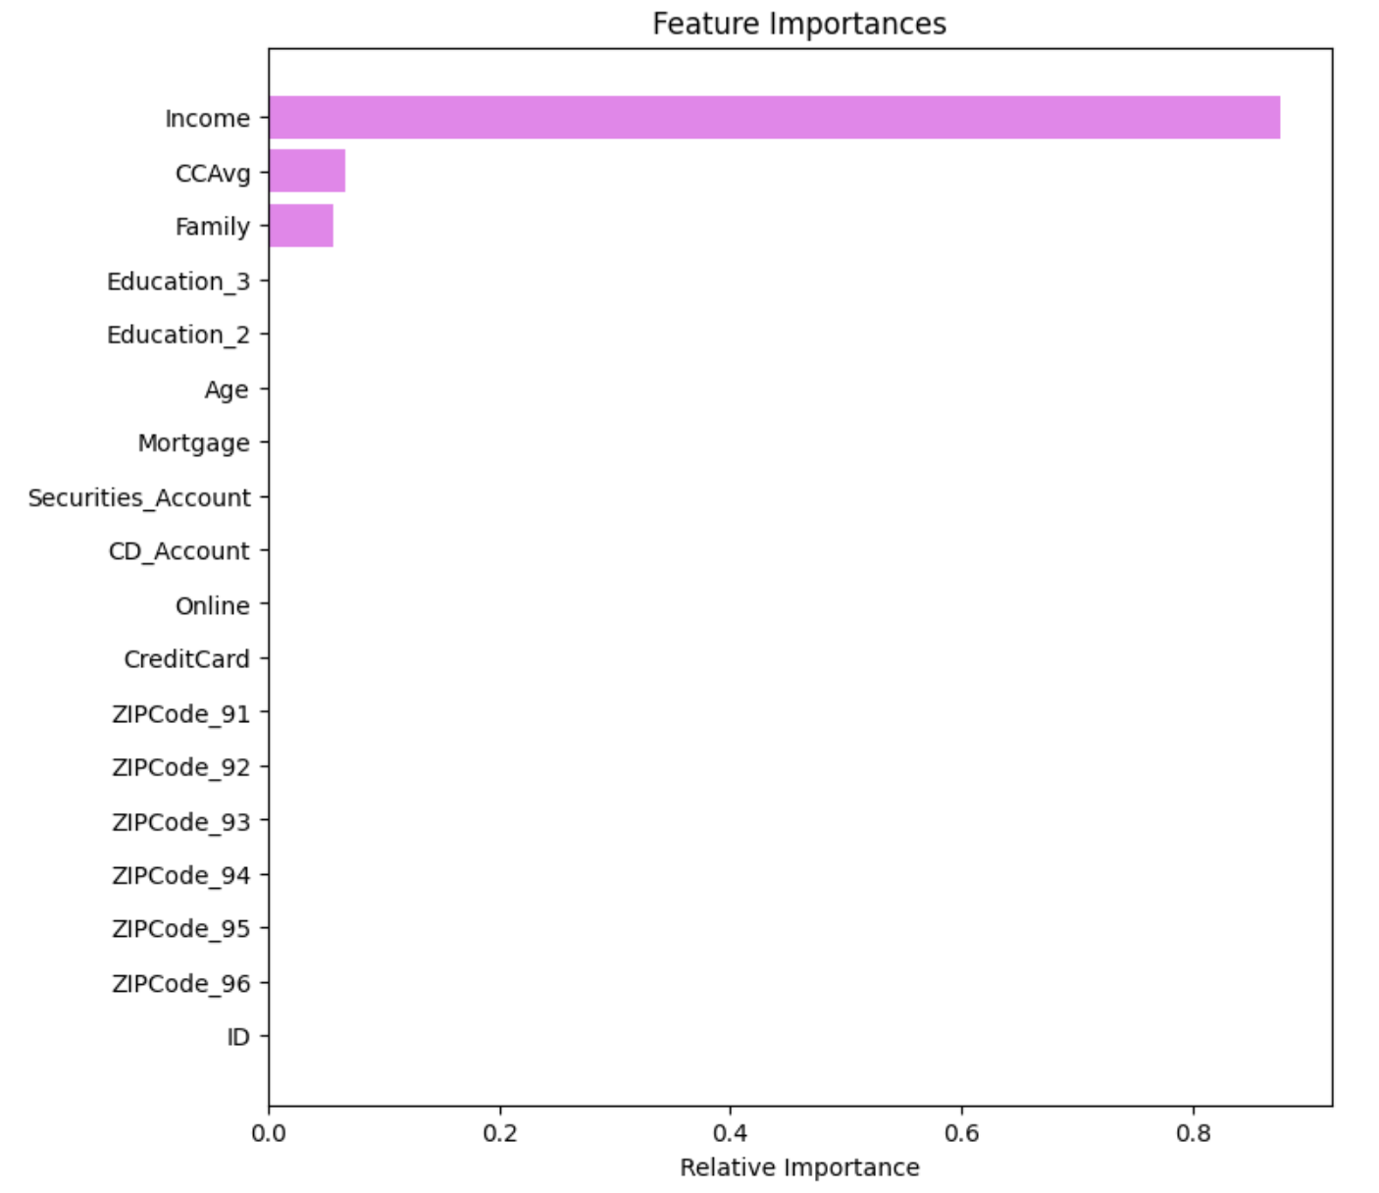
Performance Improvement by Pre-Pruning (3/4)

Slide 35
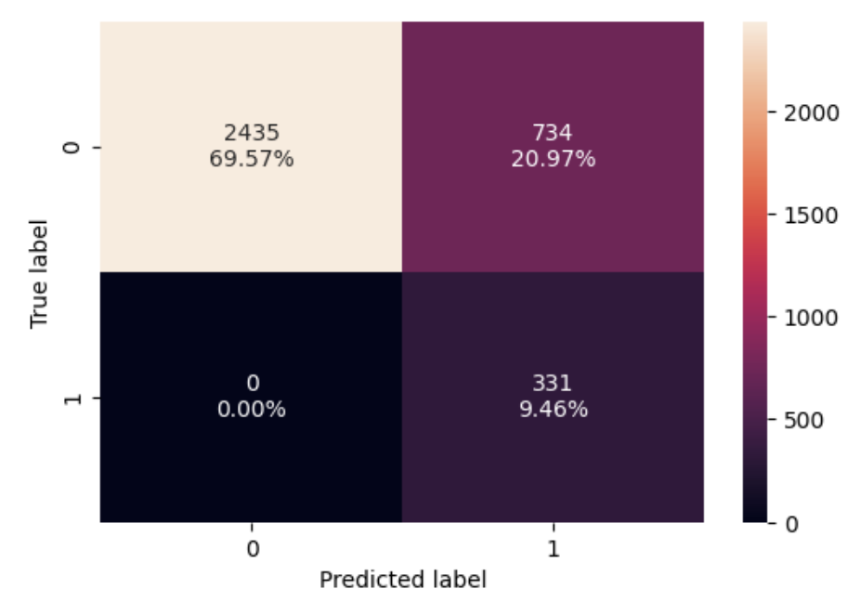
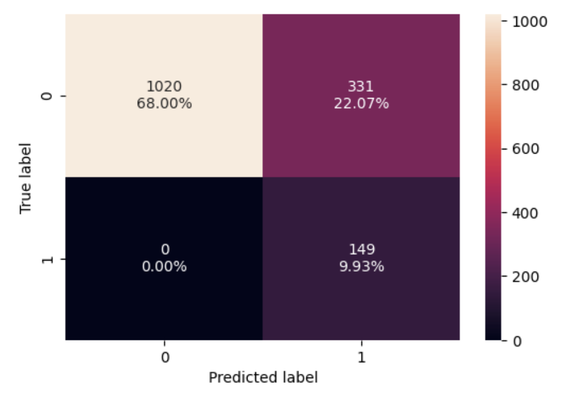
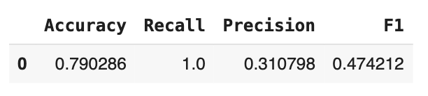
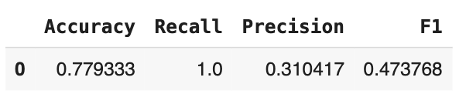
Performance Improvement by Pre-Pruning (4/4)
Training Data
Test Data

Slide 36

Performance Improvement by Post-Pruning (1/6)
✂️ Post-Pruning Approach: Cost-Complexity Pruning (ccp_alpha)
Objective: Reduce model complexity by trimming the tree after it's been fully grown —
controlling overfitting while preserving generalization.
🛠️ Steps Taken
Extract Pruning Path Used cost_complexity_pruning_path() to compute:
ccp_alphas: array of effective alphas (penalty parameters)
impurities: corresponding total impurities of leaf nodes
Visualize Impurity and other parameters vs Alpha
Plotted Total Impurity vs ccp_alpha, also plotted alpha against no of nodes, depth of tree, and Recall,
Helped visualize how complexity and impurity change with pruning
Iterative Model Training
For each ccp_alpha, a new Decision Tree was trained: clf = DecisionTreeClassifier(ccp_alpha=ccp_alpha) clf.fit(X_train, y_train)
Stored each model in a list (clfs)

Slide 37

Performance Improvement by Post-Pruning (2/6)
🌳 Characteristics of the Post-Pruned Tree
As ccp_alpha increases:
Tree depth and number of nodes decrease
The model becomes more generalized, less likely to overfit
Last tree in list (clfs[-1]):
Had the fewest nodes and shallowest depth
Represented the most aggressive pruning
Final model selection (based on recall or validation performance) would balance:
Reduced complexity
Acceptable recall and precision

Slide 38
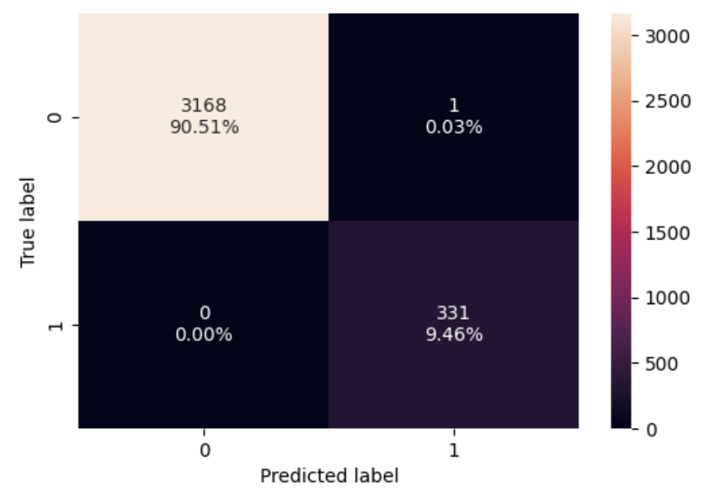
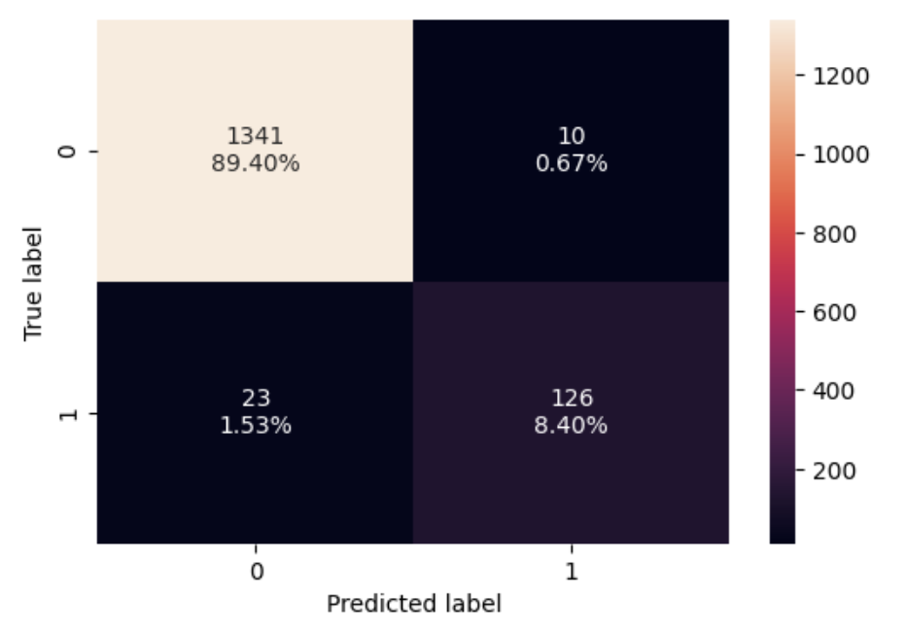
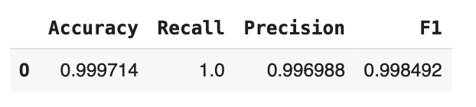
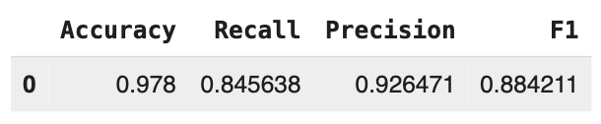
Performance Improvement by Post-Pruning (3/6)
Training Data
Test Data

Slide 39
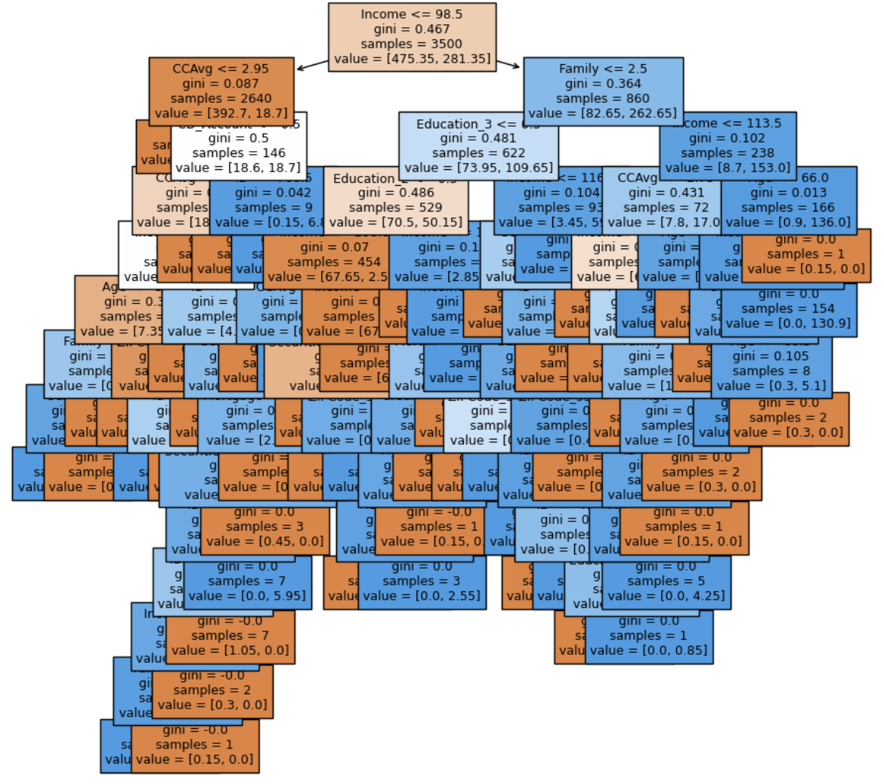
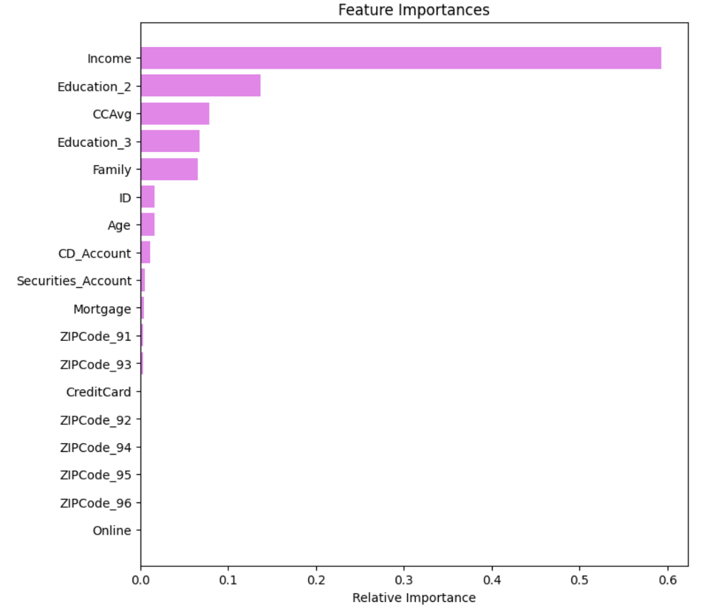
Performance Improvement by Post-Pruning (4/6)

Slide 40
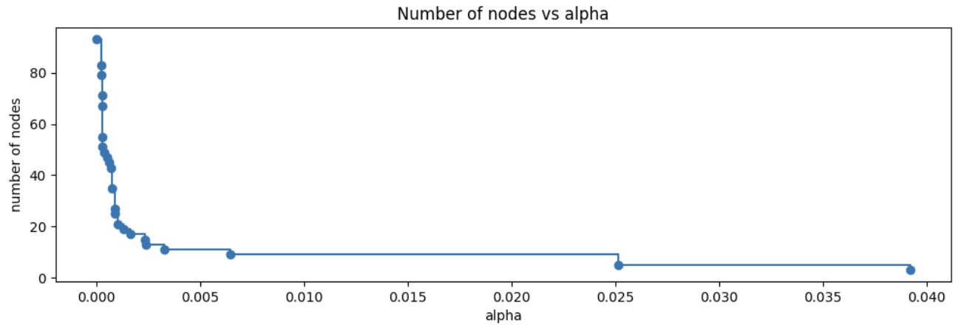
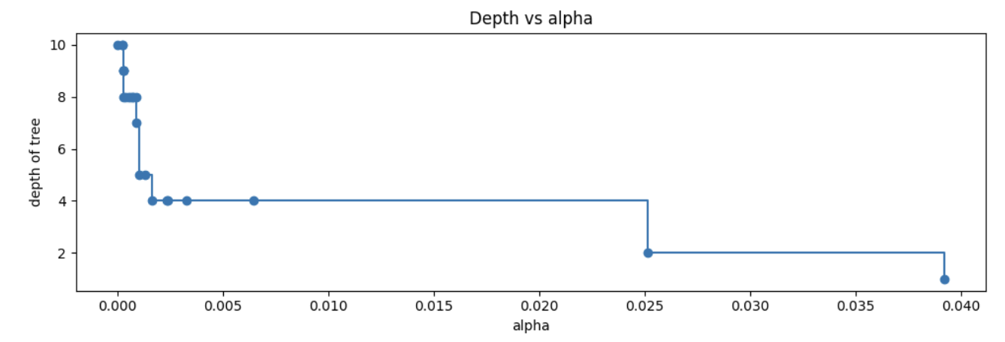
Performance Improvement by Post-Pruning (5/6)
📊 Post-Pruning Graph Analysis: Key Observations
1. Number of Nodes vs Alpha
As the ccp_alpha increases, the number of nodes sharply decreases.
This confirms that increasing the regularization parameter leads to more aggressive pruning.
The reduction in node count is non-linear, with significant drops occurring at certain alpha thresholds.
2. Tree Depth vs Alpha
Tree depth steadily decreases with increasing ccp_alpha.
Indicates a simpler tree structure as alpha increases.
Eventually flattens out, meaning further pruning has minimal effect (suggests the model is close to a stump).
🧠 Insights
Smaller alpha values retain more complex trees (higher depth and node count), which may overfit.
Larger alpha values create simpler trees that are likely better at generalizing.
The goal is to select an alpha that balances depth (complexity) and generalization by comparing performance on test data.

Slide 41

Performance Improvement by Post-Pruning (6/6)
📉 Post-Pruning: Training vs Testing Accuracy Analysis
🔍 Training Accuracy
Starts high at low ccp_alpha (complex trees fit training data well)
Gradually decreases as ccp_alpha increases (tree becomes simpler)
Reflects reduced capacity to memorize training data due to pruning
🔎 Testing Accuracy
Initially rises slightly, indicating reduced overfitting
Peaks at an optimal mid-range alpha — best generalization
Then declines at higher ccp_alpha values — model becomes underfit
🧠 Key Insights
There's a sweet spot where testing accuracy is maximized — indicating the ideal ccp_alpha for pruning
Beyond this point, both underfitting and performance degradation occur
Reinforces the need for validation-based alpha selection, not just complexity reduction

Slide 42


Model Performance Comparison (1/2)

Slide 43

Model Performance Comparison (2/2)
Observations for Training Data:
Post-pruning greatly improves training performance across all metrics, bringing them almost to 1, similar to the default unpruned tree.
Pre-pruning underperforms in terms of precision and F1 score, despite having perfect recall. This indicates many false positives (low precision), reducing its effectiveness.
Observations for Test Data:
Post-pruning significantly improves generalization, with high accuracy, precision, and F1 score on the test set.
Pre-pruning again shows perfect recall but at the cost of very low precision, leading to a poor F1 score. It clearly overpredicts the positive class.
Post-pruning achieves a balanced trade-off between precision and recall, resulting in a much higher F1 score.
Overall Summary:
Pre-pruning fails to balance model performance, especially on the test set, due to poor precision and resulting low F1 score, despite perfect recall.
Post-pruning offers much better generalization and balanced performance, making it the more effective pruning strategy.
Default (unpruned) decision tree severely overfits on the training set but performs well on the test set, although post-pruning provides a more controlled generalization without overfitting.

Slide 44
Key Decision Rules (1/2)
Key decision rules are based on: Income, Credit Card Spend (CCAvg), Education, and Family size. The following table gives a summary of the key decision rules:
Condition | Prediction | Insight
Income <= 94.5 AND CCAvg <= 2.95 | No Loan | Low income and low credit card usage — low likelihood
Income <= 94.5 AND 2.95 < CCAvg <= 4.2 AND Income > 82.5 | Loan | Higher spender in lower-income range — moderate likelihood
Income > 94.5 AND Education <= 1.5 AND Family > 2.5 AND Income > 102 | Loan | Larger families with higher income — good candidates
Income > 94.5 AND Education > 1.5 AND Income > 114.5 | Loan | High income + advanced education — very high likelihood
Income > 94.5 AND Education <= 1.5 AND Family <= 2.5 AND Income > 103.5 | No Loan | Small families with undergrad education at high income — unlikely
Income > 94.5 AND Education > 1.5 AND Income <= 114.5 AND CCAvg > 2.45 | Loan | High spender and advanced education — strong target
Income <= 94.5 AND CCAvg > 4.2 | No Loan | Very high spenders with low income — likely unstable or atypical

Slide 45

Key Decision Rules - Tree View (2/2)

Slide 46

Key Features for Loan Prediction
Income (66% importance): Most critical factor — higher income correlates strongly with loan acceptance.
Family Size (14%): Larger families with sufficient income show increased likelihood to accept loans, possibly due to higher financial responsibilities.
Credit Card Average Spend (CCAvg) (10%): Indicates spending behavior; higher CCAvg suggests more active financial profiles and interest in credit products.
Education Level (10%): Customers with graduate or advanced degrees are more likely to take loans, possibly due to greater financial literacy or needs.

Slide 47

Actionable Insights (1/2)
1. Target High-Income Customers
Accepted Loan Avg Income: $144K
Did Not Accept Loan Avg Income: $66K
Customers earning above $100K are significantly more likely to take a loan.
📌 Recommendation: Focus campaigns on customers earning >$100K, especially those in the $120K–$170K range.
2. Leverage CD Account Holders
These customers can be good candidates for the Personal Loan
📌 Recommendation: Prioritize cross-selling loans to CD account customers. Send personalized offers.

Slide 48

Actionable Insights (2/2)
3. Education Matters
Loan acceptance rate increases with education level:
Undergrad: 4.4%
Graduate: 13%
Advanced/Professional: 13.7%
📌 Recommendation: Create tiered messaging by education level, emphasizing flexible terms for highly educated professionals.
4. High Credit Card Spenders Are Likely Prospects
Loan acceptors spend ~3.9x more on credit cards monthly than non-acceptors (avg: $3.9K vs. $1.7K)
📌 Recommendation: Use CCAvg > $2.5K as a segmentation filter for outreach.
5. Family Size of 2–3 Members Shows Higher Uptake
📌 Recommendation: Consider bundling financial planning tools or family benefit messaging for this segment.

Slide 49

Strategic Marketing Campaign Recommendations
✅ Multi-channel targeting: Use email + mobile push for high-income + highly educated customers.
✅ Personalized offers: Customize interest rates and terms based on income and spending behavior.
✅ Cross-sell within banking ecosystem: Start with customers using multiple products (e.g., CD + credit card).
✅ A/B test messaging: Try different hooks for undergrad vs. graduate vs. professional segments.

Slide 50

Final Conclusions
1. Strong Predictors of Loan Acceptance Identified
Income, Education, and Credit Card Spend (CCAvg) are the top predictors of loan acceptance.
Customers with higher income, greater spending behavior, and existing engagement with bank products are significantly more likely to take loans.
2. Demographic & Behavioral Trends
Highly educated individuals (graduate and professional degree holders) show higher loan adoption rates.
Customers with CD accounts are more likely to accept loans.
High credit card spenders (>$2.5K/month) are also strong candidates.
Age and experience do not significantly influence loan decisions.
3. Modeling & Predictive Power
A Decision Tree classifier with pruning (both pre- and post-pruning) successfully predicts loan acceptance with strong recall and generalization.
Post-pruning via ccp_alpha leads to a well-balanced model, reducing overfitting while maintaining performance.

Slide 51

Business Recommendations (1/2)
🎯 1. Precision Targeting for Marketing Campaigns
Focus campaign resources on:
Customers with Income > $100K
Customers with Credit Card Spending > $2.5K/month
Customers with Graduate or Advanced degrees
These groups show the highest likelihood of loan acceptance and yield the best ROI on marketing spend.
🔁 2. Product Bundling Strategy
Introduce loan bundling options or discounts for customers with higher education or credit cards.
Promote personal loans as part of broader financial wellness tools tailored to high-spending, high-income customers.

Slide 52

Business Recommendations (2/2)
💡 3. Smart Segmentation and Messaging
Use education level and spending behavior to craft personalized messaging.
Example: Highlight low interest rates for professionals and flexible terms for families with 2–3 members.
🔍 4. Continuous Model Monitoring & Refresh
Retrain and tune the model periodically using recent customer data to reflect changing market dynamics and customer behavior.

Slide 53

Recommendations for Missing or Additional Data (1/6)
🔍 1. Identify Business Owners or Self-Employed Customers
Why?
High-income business owners often have cash flow variability and might seek loans to stabilize operations or invest.
What to Collect:
Employment type: salaried vs. self-employed
Business ownership status
Years in business or industry
Business Outcome:
Enable targeted offers to high-income self-employed individuals, who may not have taken personal loans yet but are strong prospects.

Slide 54

Recommendations for Missing or Additional Data (2/6)
🧾 2. Include Existing Debt & Liabilities
Why?
Customers with higher debt may be ineligible or may seek debt consolidation loans.
What to Collect:
Credit utilization ratios
Outstanding loans (auto, mortgage, student loans)
Total monthly debt obligations
Business Outcome:
Better risk profiling
Offer debt restructuring or consolidation loans as personalized solutions

Slide 55

Recommendations for Missing or Additional Data (3/6)
💳 3. Add Detailed Credit History or Score
Why?
Credit score is a strong predictor of both loan eligibility and repayment behavior.
What to Collect:
Credit score range
Missed payments or delinquency flags
Length of credit history
Business Outcome:
Improve loan risk management
Increase approval rates while reducing defaults

Slide 56

Recommendations for Missing or Additional Data (4/6)
📈 4. Capture Behavioral & Digital Engagement Metrics
Why?
Digitally active customers are more likely to respond to offers and easier to target.
What to Collect:
Mobile banking app usage
Website logins and feature interactions
Responses to previous campaigns
Business Outcome:
Focus campaigns on digitally engaged users
Personalize channels and timing of communication

Slide 57

Recommendations for Missing or Additional Data (5/6)
💼 5. Track Life Events and Income Trends
Why?
Life events (marriage, child, relocation) often trigger loan needs.
What to Collect:
Changes in income levels over time
Life milestones (if inferred via transaction data or voluntary input)
Business Outcome:
Preemptively offer loans tied to life events, increasing acceptance likelihood

Slide 58

Recommendations for Missing or Additional Data (6/6)
🧠 6. Label High-Potential Untapped Segments
Why?
There may be customers who resemble current loan acceptors but haven’t been offered one.
What to Do:
Use clustering or unsupervised ML to segment customers who resemble loan acceptors but haven’t opted in yet.
Examples: High-income + high CCAvg + active CD account but no loan yet.
Business Outcome:
Unlock hidden value by targeting lookalike customers who haven’t yet converted

